Slide 1
Deep Learning Part 1
Convolutional Networks
Slides by:
Joseph E. Gonzalez,
jegonzal@berkeley.edu

Slide 2

Quick Logistics
http://bit.ly/aisys-sp19
Please sign up to present
Complete reading questions before lecture

Slide 3
Outline
Crash course in supervised learning
Loss Minimization and Function Approximators
Features Functions
Convolutional Networks
Intuition
LeNet
Two Papers:
AlexNet Paper: First Big Deep Learning ILSVRC Result
Inception v4: Latest Big Deep Learning ILSVRC Result

Slide 4
Machine Learning Crash Course
Supervised Learning

Slide 5

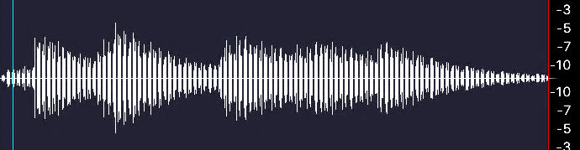
Machine Learning ≈ Function Approximation
Object Recognition
Speech Recognition
“The cat in the hat”
Label:Cat
Robotic Control
Machine Translation
El gato en el sombrero
The cat in the hat.

Slide 6



Supervised Machine Learning
Given data containing the function inputs and outputs
Data
Model
Goal
Loss
Input | Output
X₁ | Y₁
X₂ | Y₂
… | …
X_{n} | Y_{n}
cat
Parameters
Over all future data
baby
Training (approximates the goal over training data):
baby

Slide 7
Focus of next two lectures
How do we make our functions sufficiently expressive
Capture domain knowledge / assumptions
Easy to train and compute

Slide 8
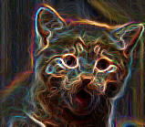
Classical* Machine Learning
Break function into features and learned model
Example
Generic Easy to Train Function (Linear Model)
Hand Engineered Features
SVM
Label:Cat
* This is also very frequently used today as well.

Slide 9
Function Approximation Pipeline
SVM
Label:Cat
Often build multiple layers of features to abstract the input
SVM
Label:Cat
Deep learning tries to automate this process.

Slide 10
Function Approximation Pipeline
Learn more abstract representation
SVM
Low-level
Features
Mid-level
Features
High-level
Features
Label:Cat
Deep Learning: automatically learns a deep hierarchy of abstract features along with the classifier.
Typically using neural networks
composable general function approximators

Slide 11
Can we build a generic function for all tasks?
Multi-layer Neural Network
Single “Neuron”
Shown to be Universal Approximators [Holt et al. 1989]
Given enough hidden units, a single hidden layer network can approximate any continuous function.
Too generic for most tasks → difficult to train
Images courtesy of http://cs231n.github.io/
Notes:
Images courtesy of http://cs231n.github.io/neural-networks-1/

Slide 12
Focus on Computer Vision Tasks
Hidden Layer
Many parameters!
Learns to detect cats in top left corner

Slide 13
Focus on Computer Vision Tasks
Hidden Layer
Many parameters!
Learns to detect cats in top left corner
Changes in position would require a new hidden unit.
Doesn’t capture spatial invariance.

Slide 14
Convolutional Networks
High-level Intuition
Hidden Layer
Filter Weights

Slide 15
Convolutional Networks
High-level Intuition
Hidden Layer
Filter Weights

Slide 16
Convolutional Networks
High-level Intuition
Hidden Layer
Filter Weights

Slide 17
Convolutional Networks
High-level Intuition
Hidden Layer
Filter Weights

Slide 18
Convolutional Networks
High-level Intuition
Hidden Layer
Filter Weights

Slide 19
Convolutional Networks
High-level Intuition
Image
Filter
Multiply Pixels by Filter
Take the sum
Activation
Max
Above
Threshold?
Triangle
Found
We can learn the filter.

Slide 20
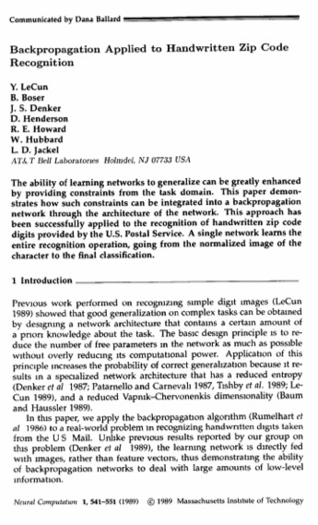
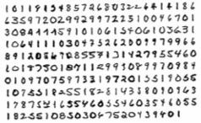
LeNet [1989]
Credited with introduced weight sharing equivalent to convolution.
High accuracy on digit recognition
An important problem for postal routing
Used backpropagation and stochastic gradient during training
Implemented on DSP for fast inference
30 digits per second on DSP
(10 to 12) for entire pipeline
Predecessor to
MNIST Digits
Dataset

Slide 21
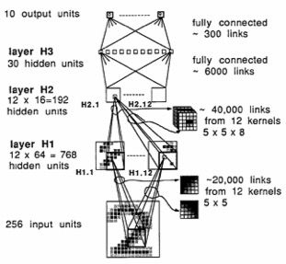
LeNet Architecture
Tensor Illustration
Input Image
5
8
4
16
5
8
12
4
16
12
1

Slide 22
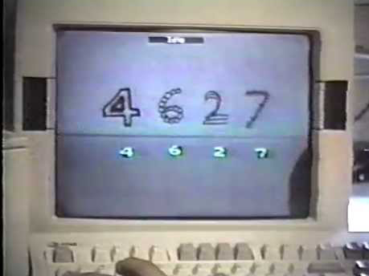
Yann LeCun
1993 LeNet1
Demo

Slide 23
LeNet5 [1998]
2x2
5x5
Directly used convolution terminology
Major commercial success in check reading systems
reading between 10 and 20% of all the checks in the US in the early 2000s.

Slide 24
Papers

Slide 25
ImageNet Classification with Deep Convolutional Neural Networks
Alex Krizhevsky, Illya Sutskever, Geoffrey E. Hinton
Presented by Joseph E. Gonzalez
TL;DR; This paper describe the deep convolutional architecture, training techniques, and system innovations that resulted in the winning entry for the ILSVRC-2012 Benchmark. This model substantially outperformed the next best model that year.

Slide 26
What is the problem being solved?
Image-Net Benchmark (ILSVRC-2012)
1.2M hand labeled (1000 classes) real-world images
Images have varying resolutions
Multiple tasks including
Classification – algorithm may return 5 predictions per image
Classification with Localization – Classification + a bounding box
Fine-Grained Classification; – 100+ dog subcategories.

Slide 27
About the Problem
Is this an important problem?
Not directly, however the resulting models could be readily applied to a wide range of more specialized tasks.
Is this problem hard?
Yes! Humans often make mistakes.
Prediction accuracy on earlier related tasks was relatively low
Is this problem novel?
Yes! The ILSVRC had only been around for two years.

Slide 28
What are the metrics of success?
Top-1 and top-5 validation and test accuracy
ILSVRC published 100,000 test images without labels and 50,000 validation images with labels
Top-5 Accuracy: model predict 5 possible categories
The model is correct if the human label matches any of the top 5
Top-1 Accuracy: model prediction must match human label
Human labels were occasionally wrong and multiple items in each image.
Test results reported at the end of the competition
Difficult to overfit.
Did not directly include computation time

Slide 29
What is the key innovation?
Eliminated the use of engineered features and achieved more than a 40% reduction in error compared to next best model (which used hand engineered features).
Combined innovations in neural network architecture with innovations in hardware accelerated training
Extensive use of ReLU non-linearities
Training on Multiple GPUs
Local Response Normalization
Reduced Overfitting using data augmentation and dropout

Slide 30
The Actual AlexNet* Architecture
from the paper
*Posthumously Named

Slide 31
The AlexNet* Architecture Without GPU Partitioning
*Posthumously Named

Slide 32
The AlexNet* Architecture (Cleaner Presentation)
Resp.
Norm
Resp.
Norm
ReLU Nonlinearities are applied after every conv and FC layer
Image from https://neurohive.io/en/popular-networks/alexnet-imagenet-classification-with-deep-convolutional-neural-networks/

Slide 33
Rectified Linear Units (ReLU)
Recall
Historically it was common to use
Rectified Linear Units
Enable faster training of deep networks.
tanh
Vanishing
Gradients
Sigmoid
Gradient
doesn’t
vanish
“Dying ReLU” is only an issue if an activation is zero for all inputs.

Slide 34
Rectified Linear Units (ReLU)
Recall
Historically it was common to use
Rectified Linear Units
Enable faster training of deep networks.
Lots of ablation studies
CIFAR-10 Micro Benchmark
tanh
Vanishing
Gradients
Sigmoid
tanh
Gradient
doesn’t
vanish
ReLU
“Dying ReLU” is only an issue if an activation is zero for all inputs.
Passes through dataset.

Slide 35
Training on Multiple GPUs
Limited by GPU memory using Nvidia GTX 580 (3GB RAM)
60M Parameters ~ 240 MB
Need to cache activation maps for backpropagation
Batch size = 128
128 * (227*227*3 + 55*55*96*2 + 96*27*27 + 256*27*27*2 + 256*13*13 + 13*13*384 + 384*13*13 + 256*13*13 + 4096 + 4096 + 1000) Parameters ~ 718MB
That assuming no overhead and single precision values
Tuned splitting across GPUS to balance communication and computation

Slide 36
The Actual AlexNet* Architecture
from the paper
*Posthumously Named

Slide 37
Interesting Consequence of Partitioned Training
Edge Detection
Color Filters

Slide 38
Local Response Normalization
The use of ReLU non-linearity → large activation values
Needed a mechanism to normalize large activations
Channel Dimension
Parameters used in the paper:
Determined using cross validation on a smaller network.

Slide 39
Data Augmentation (Established Technique)
Used small translations and reflections of images
Added random transformations along eigen color-space.
Image transformations done in Python on CPU while GPU is training on previous batch.
Today this is increasingly a bottleneck

Slide 40
Dropout on Fully Connected Layers (Established Technique.)
Randomly zero activations (with prob. 0.5) during training
Reduces co-adaptation of neurons
Ensures more robust features
Simulates training an ensemble of sparse architectures

Slide 41
Key Results

Slide 42
Put into historical context
AlexNet

Slide 43
Qualitative Results

Slide 44
Good Embeddings …
Embedding Layer
This will later be the foundation of many papers
Query
Images with largest dot product with query

Slide 45
Limitations and Opportunities
Model architecture is determined by system, what happens when GPUs get faster or bigger?
Multiple fully connected layers → many parameters
Images are assumed fixed input size
Many hyper-parameters to tune
Implementation in CUDA is hard to extend

Slide 46
Long term impact
Cited by over 34,000 papers
Used as features in many other computer vision models
Follow-up work on Caffe made the models more accessible
The model, code, and many of the techniques have largely been replaced but this work shaped contemporary computer vision and helped elevate deep learning in the ML and CV communities.

Slide 47
ImageNet 2012 → 2015

